Slide 1
Modeling
Koorush Ziarati
Shiraz University

Slide 3
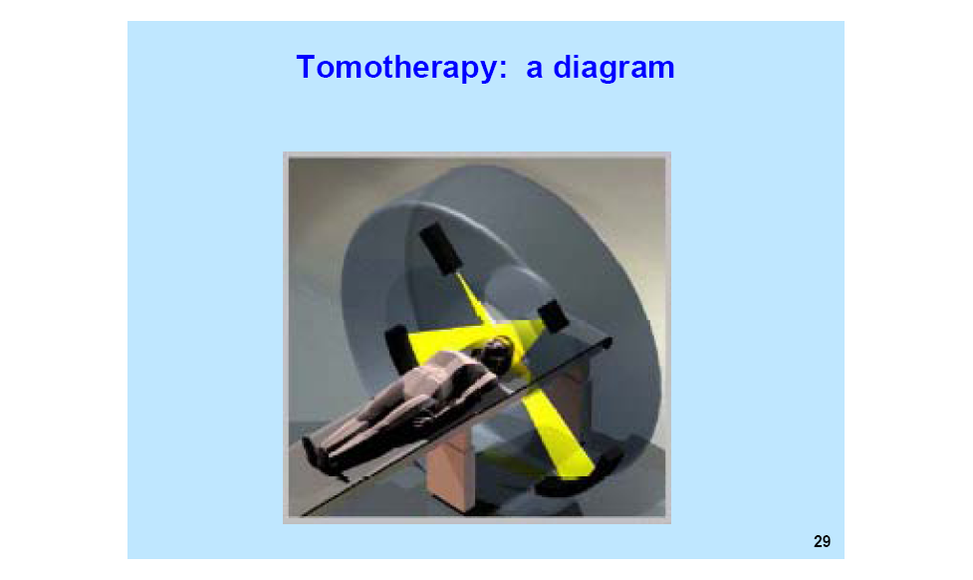

Slide 4
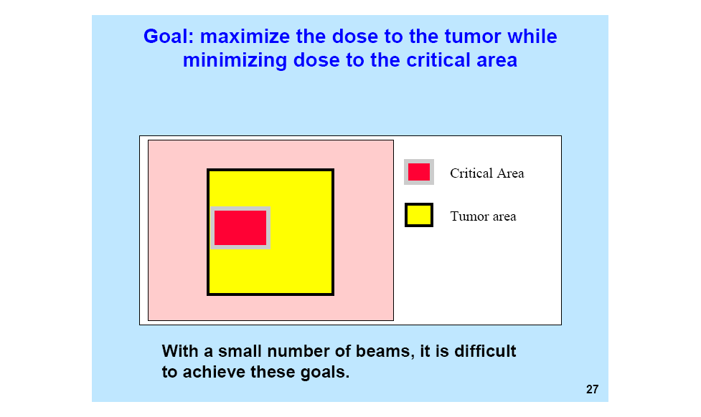

Slide 5
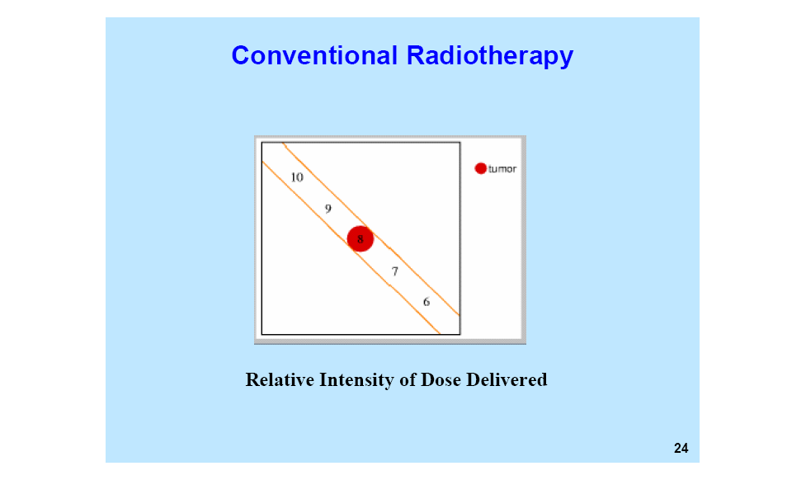

Slide 6


Slide 7


Slide 8


Slide 9


Slide 10
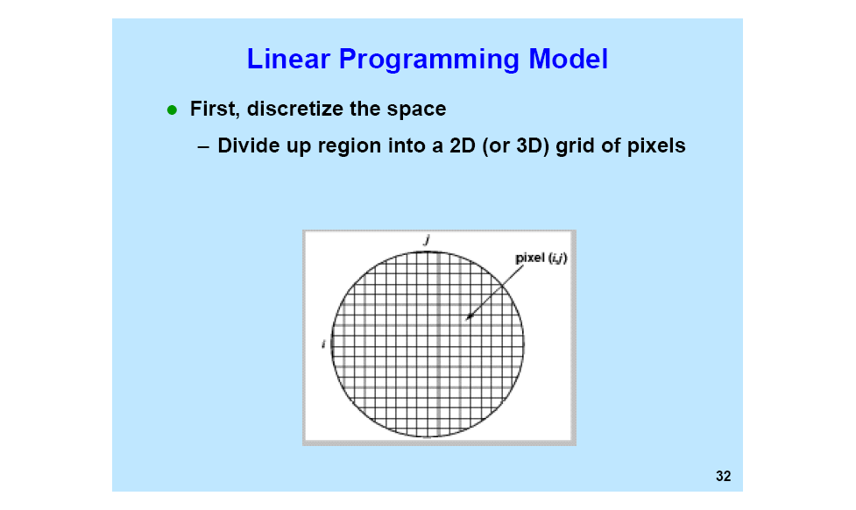

Slide 11
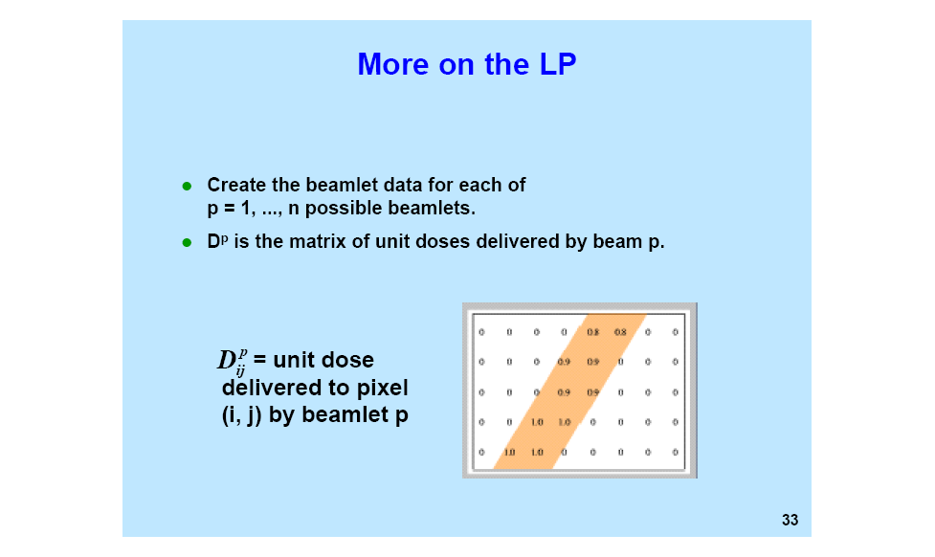

Slide 12
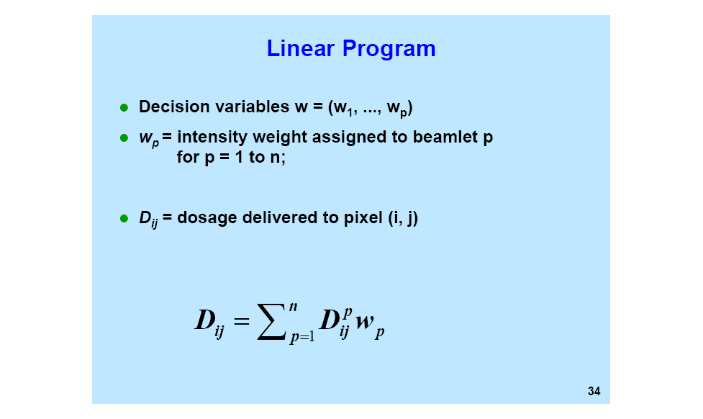

Slide 13
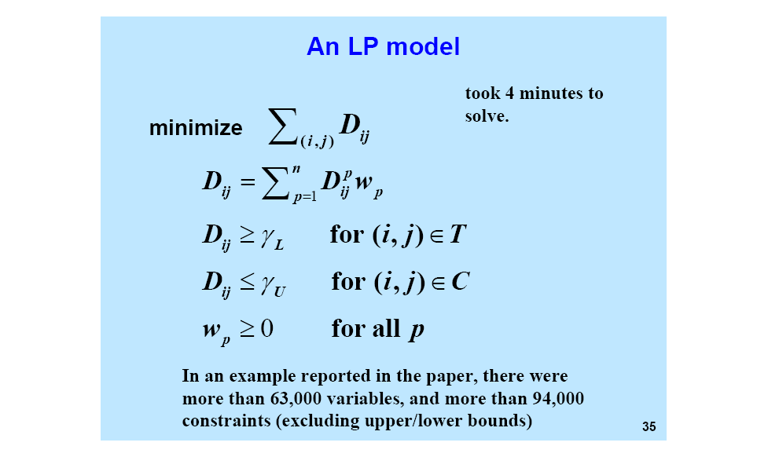

Slide 14
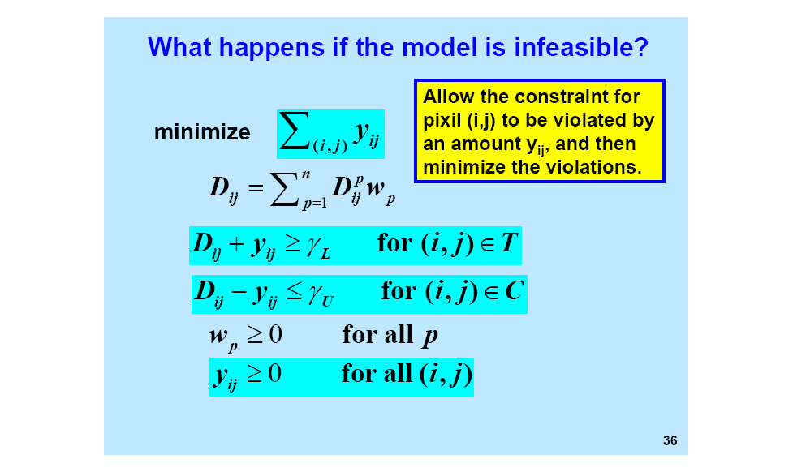

Slide 15
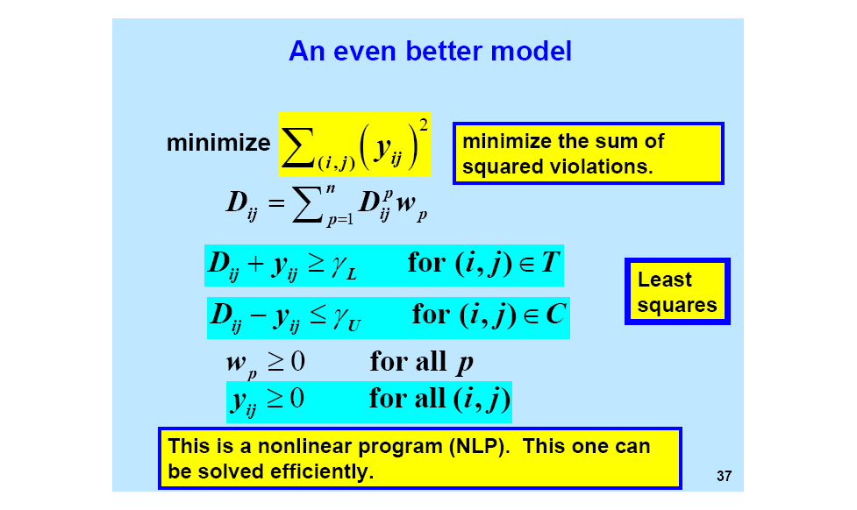

Slide 16


Slide 17


Slide 28
Hamdy Taha page 27

Slide 39
Example 1: The Burroughs garment company manufactures men's shirts and women’s blouses for Walmark Discount stores. Walmark will accept all the production supplied by Burroughs. The production process includes cutting, sewing and packaging. Burroughs employs 25 workers in the cutting department, 35 in the sewing department and 5 in the packaging department. The factory works one 8-hour shift, 5 days a week. The following table gives the time requirements and the profits per unit for the two garments:
Minutes per unit
Garment | Cutting | Sewing | Packaging | Unit profit($)
Shirts | 20 | 70 | 12 | 8.00
Blouses | 60 | 60 | 4 | 12.00
Determine the optimal weekly production schedule for Burroughs.

Slide 40
Solution: Assume that Burroughs produces x₁ shirts and x₂ blouses per week.
8 x₁ + 12 x₂
Profit got =
Time spent on cutting =
20 x₁ + 60 x₂ mts
Time spent on sewing =
70 x₁ + 60 x₂ mts
Time spent on packaging =
12 x₁ + 4 x₂ mts

Slide 41
The objective is to find x₁, x₂ so as to
maximize the profit z = 8 x₁ + 12 x₂
satisfying the constraints:
20 x₁ + 60 x₂ ≤ 25 × 40 × 60
70 x₁ + 60 x₂ ≤ 35 × 40 × 60
12 x₁ + 4 x₂ ≤ 5 × 40 × 60
x₁, x₂ ≥ 0, integers

Slide 42
Example 2: Wild West produces two types of cowboy hats. Type I hat requires twice as much labor as a Type II. If all the available labor time is dedicated to Type II alone, the company can produce a total of 400 Type II hats a day. The respective market limits for the two types of hats are 150 and 200 hats per day. The profit is $8 per Type I hat and $5 per Type II hat. Formulate the problem as an LPP so as to maximize the profit.

Slide 43
Solution: Assume that Wild West produces x₁ Type I hats and x₂ Type II hats per day.
Per day Profit got =
8 x₁ + 5 x₂
Assume the time spent in producing one type II hat is c minutes.
Labour Time spent is
(2 x₁ + x₂) c minutes

Slide 44
The objective is to find x₁, x₂ so as to
maximise the profit z = 8 x₁ + 5 x₂
satisfying the constraints:
(2 x₁ + x₂ ) c ≤ 400 c
x₁ ≤ 150
x₂ ≤ 200
x₁, x₂ ≥ 0, integers

Slide 45
The objective is to find x₁, x₂ so as to
maximise the profit z = 8 x₁ + 5 x₂
satisfying the constraints:
(2 x₁ + x₂ ) ≤ 400
x₁ ≤ 150
x₂ ≤ 200
x₁, x₂ ≥ 0, integers

Slide 46
Example 3: Trim Loss problem, A company has to manufacture the circular tops of cans. Two sizes, one of diameter 10 cm and the other of diameter 20 cm are required. They are to be cut from metal sheets of dimensions 20 cm by 50 cm. The requirement of smaller size is 20,000 and of larger size is 15,000. The problem is : how to cut the tops from the metal sheets so that the number of sheets used is a minimum. Formulate the problem as a LPP.

Slide 47
A sheet can be cut into one of the following three patterns:
10
10
Pattern I
Pattern II
20
10
20
10
10
Pattern III
20

Slide 48
Pattern I: cut into 10 pieces of size 10 by 10 so as to make 10 tops of size 1
Pattern II: cut into 2 pieces of size 20 by 20 and 2 pieces of size 10 by 10 so as to make 2 tops of size 2 and 2 tops of size 1
Pattern III: cut into 1 piece of size 20 by 20 and 6 pieces of size 10 by 10 so as to make 1 top of size 2 and 6 tops of size 1

Slide 49
So assume that x₁ sheets are cut according to pattern I, x₂ according to pattern II, x₃ according to pattern III
The problem is to
Minimize z = x₁ + x₂ + x₃
Subject to 10 x₁ + 2 x₂ + 6 x₃ ≥ 20,000
2 x₂ + x₃ ≥ 15,000
x₁, x₂, x₃ ≥ 0, integers

Slide 50
Example 5 :BITS wants to host a Seminar for five days. For the delegates there is an arrangement of dinner every day. The requirement of napkins during the 5 days is as follows:
Day | 1 | 2 | 3 | 4 | 5
Napkins Needed | 80 | 50 | 100 | 80 | 150
Institute does not have any napkins in the beginning. After 5 days, the Institute has no more use of napkins. A new napkin costs Rs. 2.00. The washing charges for a used one are Rs. 0.50. A napkin given for washing after dinner is returned the third day before dinner. The Institute decides to accumulate the used napkins and send them for washing just in time to be used when they return. How shall the Institute meet the requirements so that the total cost is minimized ? Formulate as a LPP.

Slide 51
Solution Let x_{j} be the number of napkins purchased on day j, j=1,2,..,5
Let y_{j} be the number of napkins given for washing after dinner on day j, j=1,2,3
Thus we must have
x₁ = 80, x₂ = 50, x₃ + y₁ = 100, x₄ + y₂ = 80
x₅ + y₃ = 150
Also we have
y₁ ≤ 80, y₂ ≤ (80 – y₁) + 50
y₃ ≤ (80 – y₁) + (50 – y₂) + 100

Slide 52
Thus we have to Minimize z = 2(x₁+x₂+x₃+x₄+x₅)+0.5(y₁+y₂+y₃)
Subject to
x₁ = 80, x₂ = 50, x₃ +y₁ =100,
x₄ + y₂ = 80, x₅ + y₃ = 150,
y₁ ≤ 80, y₁+y₂ ≤ 130, y₁+y₂+y₃ ≤ 230,
all variables ≥ 0, integers

Slide 54
Data (x,y) = { (1,2) , (3,4) , (4,7) }
y
7
•
6
5
4
•
3
2
•
1
1 2 3 4 5
x
We want to “fit” a linear function y = ax + b to these data points; i.e., we have to choose optimal values for a and b.

Slide 55
Objective: Find parameters a and b that minimize the
maximum absolute deviation between the data y_{i} and the
fitted line y_{i} = ax_{i} + b.
∧
y
∧
i
and
y
i
observed
value
Predicted
value
In addition, we’re going to impose a priori knowledge that the
slope of the line must be positive. (We don’t know about the intercept.)
Decision variables
a = slope of line
known to be positive
b = y-intercept
positive or nega
tive
b =
b
+
−
b⁻
, b
+
≥
0, b⁻
≥
0

Slide 56
Objective function:
∧
Let w =
max
{ |
y_{i}
−
y_{i}
| : i = 1, 2, 3 }
∧
where y_{i} = ax_{i} + b
Optimization model:
Min
w
∧
s.t.
w
≥
y_{i}
−
y_{i}
i = 1, 2, 3

Slide 57
Nonlinear constraints:
w ≥
∧
−
=
a(1)
+ b – 2
y
1
y
1
w ≥
∧
=
a(3)
+ b – 4
y
−
y
2
2
∧
w ≥
y
−
y
=
a(4)
+ b – 7
3
3
Convert absolute value terms to linear terms:
Note: 2 ≥|x| iff 2 ≥ x and 2 ≥ −x
∧
Thus
w
≥
y
−
y
is equivalent to
i
i
w ≥ ax_{i} + b − y_{i} and w ≥ − ax_{i} – b + y_{i}

Slide 58
so finally …
Min
w
s.t.
a + b
+
−
b
−
−
w
≤
2
−
a − b
+
+ b
−
−
w
≤
−
2
3a + b
+
−
b
−
−
w
≤
4
−
3a
−
b
+
+ b
−
−
w
≤
−
4
4a + b
+
−
b
−
−
w
≤
7
−
4a
−
b
+
+
b
−
−
w
≤
−
7
a, b
+
, b
−
≥
, w
0

Slide 61
(More) Examples of LP Formulations
1. Employee Scheduling
Macrosoft has a 24-hour-a-day, 7-days-a-week toll free hotline that is being set up to answer questions regarding a new product. The following table summarizes the number of full-time equivalent employees (FTEs) that must be on duty in each time block.
Shift
Time
FTEs
1
0-4
15
2
4-8
10
3
8-12
40
4
12-16
70
5
16-20
40
6
20-0
35

Slide 62
Constraints for Employee Scheduling
Macrosoft may hire both full-time and part-time employees. The former work 8-hour shifts and the latter work 4-hour shifts; their respective hourly wages are $15.20 and $12.95. Employees may start work only at the beginning of one of 6 shifts.
At least two-thirds of the employees working at any one time must be full-time employees.
Part-time employees can only answer 5 calls in the time a full-time employee can answer 6 calls. (i.e., a part-time employee is only 5/6 of a full-time employee.)
Formulate an LP to determine how to staff the hotline at minimum cost.

Slide 63
Decision Variables
x_{t} = # of full-time employees that begin work in shift t
y_{t} = # of part-time employees that work shift t
(8 × 15.20)
(4 × 12.95)
min
121.6 (x₁ + • • • + x₆) +
51.8 (y₁ + • • • + y₆)
s.t.
x₆ + x₁ +
5
y₁
≥
15
6
x₁ + x₂ +
5
y₂
≥
10
6
All shifts must be covered
x₂ + x₃ +
5
y₃
≥
40
6
x₃ + x₄ +
5
y₄
≥
70
6
x₄ + x₅ +
5
y₅
≥
40
6
x₅ + x₆ +
5
y₆
≥
35
6
PT employee is 5/6 FT employee

Slide 64
More constraints:
(x₆ + x₁)
≥
2
At least 2/3 workers must be full time
(x₆ + x₁ + y₁)
3
(x₁ + x₂)
≥
2
(x₁ + x₂ + y₂)
.
3
.
.
(x₅ + x₆)
≥
2
(x₅ + x₆ + y₆)
3
x_{t} ≥ 0, y_{t} ≥ 0 t =1,2, …,6
Nonnegativity

Slide 65
2. Energy Generation Problem (with piecewise linear objective)
Austin Municipal Power and Light (AMPL) would like to determine optimal operating levels for their electric generators and associated distribution patterns that will satisfy customer demand. Consider the following prototype system
Demand requirements
1
4 MW
1
Demand
sectors
Plants
2
7 MW
2
3
6 MW
The two plants (generators) have the following (nonlinear) efficiencies:
Plant 1
[ 0, 6 MW]
[ 6MW, 10MW]
Unit cost ($/MW)
$10
$25
Plant 2
[ 0, 5 MW]
[5MW, 11MW]
Unit cost ($/MW)
$8
$28
The table is to be read as follows. For plant #1 if you generate at a rate of 8MW then the cost ($/sec) is = 10(6) + 25(2) = 110.

Slide 66
Problem Statement and Notation
Formulate an LP that, when solved, will yield optimal power generation and distribution levels.
Decision Variables
x
11
= power generated at plant
1 at operating level 1
x
12
″
″
″
″
1
″
″
″
2
x
21
″
″
″
″
2
″
″
″
1
x
22
″
″
″
″
2
″
″
″
2
y
11
= power sent from plant
1 to demand sector 1
y
12
″
″
″
″
1 ″ ″ ″
2
y
13
″
″
″
″
1
″
″
″
3
y
21
″
″
″
″
2
″
″
″
1
y
22
″
″
″
″
2
″
″
″
2
y
23
″
″
″
″
2
″
″
″
3

Slide 67
Formulation
Min
10x
11
+
25x
12
+
8x
21
+
28x
22
s.t.
y
11
+
y
12
+
y
13
=
x
11
+
x
12
y
21
+
y
22
+
y
23
=
x
21
+
x
22
y
11
+
y
21
=
4
y
12
+
y
22
=
7
y
13
+
y
23
=
6
0
≤
x
≤
6,
0
≤
x
4
11
12
≤
0
≤
x
≤
5,
y
0
≤
x
≤
6
21
y
22
y
,
y
,
y
,
y
,
,
≥
0
11
12
13
21
22
23
Note that we can model the nonlinear operating costs with an LP only because the efficiencies have the right kind of structure. In particular, the plant is less efficient (more costly) at higher operating levels. Thus the LP solution will automatically select level 1 first.

